Slide 1
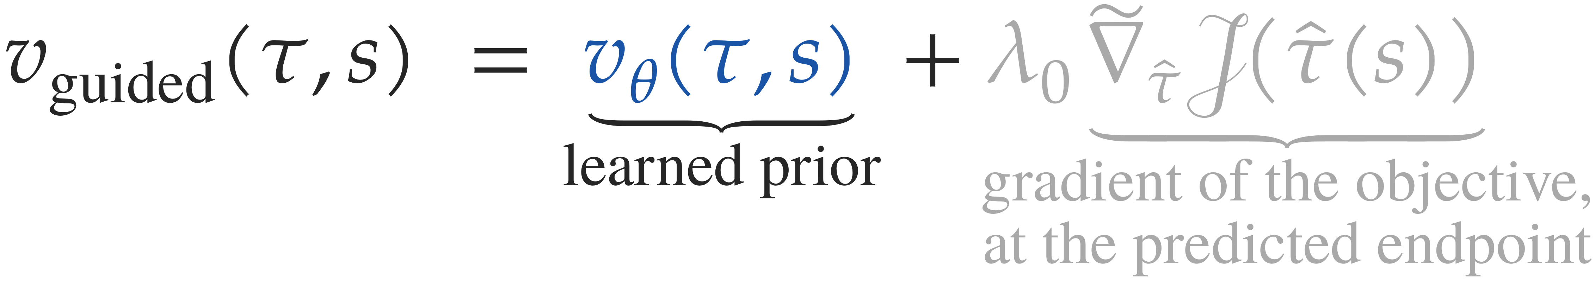
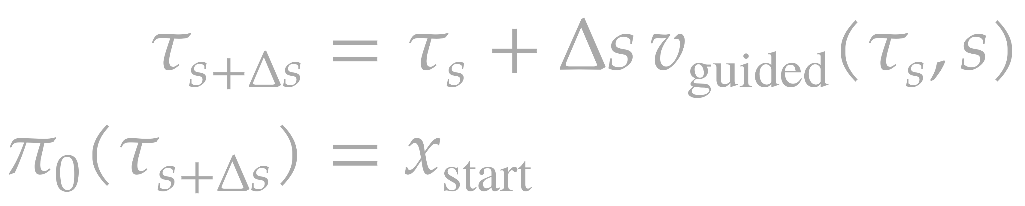
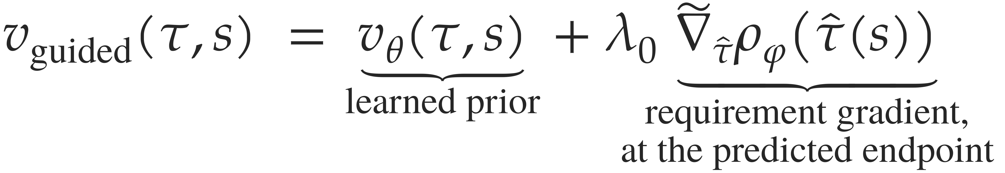
Guided velocity field
extrapolation to s = 1
τ̂, s = 1
γ Σ_{t} ‖p_{t+1} − 2p_{t} + p_{t−1}‖²
smoothness penalty
τ_{s}, s
v_{θ}(τ_{s}, s)
learned prior field
frozen during sampling
τ̂ = τ_{s} + (1 − s) v_{θ}
predicted endpoint
ρ_{φ}(τ̂)
requirement score
+
−
τ_{s}
vθ
Σ
objective 𝒥(τ̂)
λ₀ ĝ Δs
guidance term
mask and normalize
constrained coordinates to
unit direction
∇τ̂
autodiff
λ₀ ĝ Δs
vθ Δs
+
Δτ̃
re-pin
π₀(τ) = x_{start}
τ_{s+Δs}
K steps
Notes:
Exact native redraw of the thesis figure fig_guided_sampler.tex (one guided Euler step as a dataflow), for reference. Standalone file; not part of the talk.

Slide 2
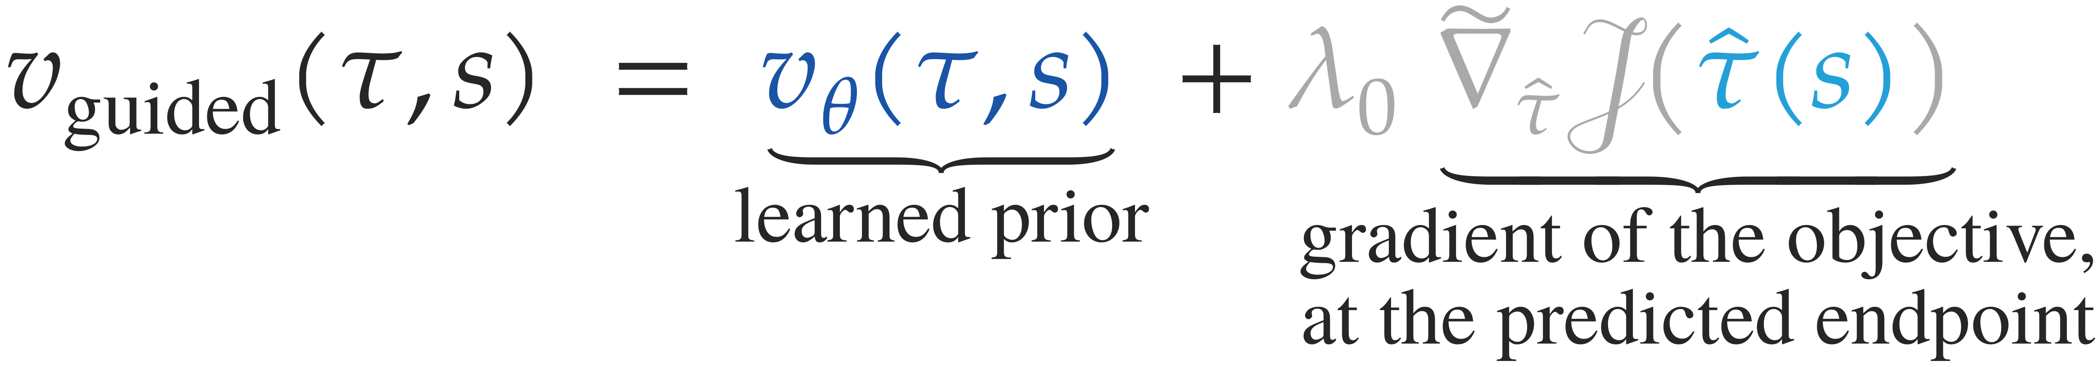
Guided velocity field
extrapolation to s = 1
τ̂, s = 1
γ Σ_{t} ‖p_{t+1} − 2p_{t} + p_{t−1}‖²
smoothness penalty
τ_{s}, s
v_{θ}(τ_{s}, s)
learned prior field
frozen during sampling
τ̂ = τ_{s} + (1 − s) v_{θ}
predicted endpoint
ρ_{φ}(τ̂)
requirement score
+
−
τ_{s}
vθ
Σ
objective 𝒥(τ̂)
λ₀ ĝ Δs
guidance term
mask and normalize
constrained coordinates to
unit direction
∇τ̂
autodiff
λ₀ ĝ Δs
vθ Δs
+
Δτ̃
re-pin
π₀(τ) = x_{start}
τ_{s+Δs}
K steps
Notes:
Exact native redraw of the thesis figure fig_guided_sampler.tex (one guided Euler step as a dataflow), for reference. Standalone file; not part of the talk.

Slide 3
Guided velocity field
extrapolation to s = 1
τ̂, s = 1
γ Σ_{t} ‖p_{t+1} − 2p_{t} + p_{t−1}‖²
smoothness penalty
τ_{s}, s
v_{θ}(τ_{s}, s)
learned prior field
frozen during sampling
τ̂ = τ_{s} + (1 − s) v_{θ}
predicted endpoint
ρ_{φ}(τ̂)
requirement score
+
−
τ_{s}
vθ
Σ
objective 𝒥(τ̂)
λ₀ ĝ Δs
guidance term
mask and normalize
constrained coordinates to
unit direction
∇τ̂
autodiff
λ₀ ĝ Δs
vθ Δs
+
Δτ̃
re-pin
π₀(τ) = x_{start}
τ_{s+Δs}
K steps
Notes:
Exact native redraw of the thesis figure fig_guided_sampler.tex (one guided Euler step as a dataflow), for reference. Standalone file; not part of the talk.

Slide 4
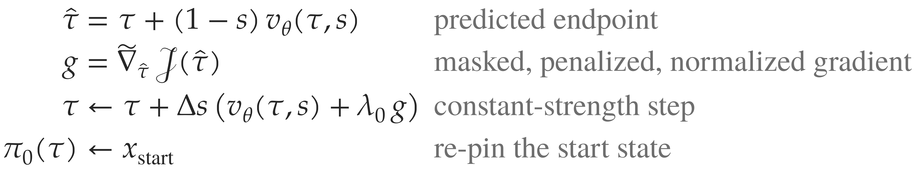
Guided velocity field
extrapolation to s = 1
τ̂, s = 1
γ Σ_{t} ‖p_{t+1} − 2p_{t} + p_{t−1}‖²
smoothness penalty
τ_{s}, s
v_{θ}(τ_{s}, s)
learned prior field
frozen during sampling
τ̂ = τ_{s} + (1 − s) v_{θ}
predicted endpoint
ρ_{φ}(τ̂)
requirement score
+
−
τ_{s}
vθ
Σ
objective 𝒥(τ̂)
λ₀ ĝ Δs
guidance term
mask and normalize
constrained coordinates to
unit direction
∇τ̂
autodiff
λ₀ ĝ Δs
vθ Δs
+
Δτ̃
re-pin
π₀(τ) = x_{start}
τ_{s+Δs}
K steps
Notes:
Exact native redraw of the thesis figure fig_guided_sampler.tex (one guided Euler step as a dataflow), for reference. Standalone file; not part of the talk.

Slide 5

Guided velocity field
extrapolation to s = 1
τ̂, s = 1
γ Σ_{t} ‖p_{t+1} − 2p_{t} + p_{t−1}‖²
smoothness penalty
τ_{s}, s
v_{θ}(τ_{s}, s)
learned prior field
frozen during sampling
τ̂ = τ_{s} + (1 − s) v_{θ}
predicted endpoint
ρ_{φ}(τ̂)
requirement score
+
−
τ_{s}
vθ
Σ
objective 𝒥(τ̂)
λ₀ ĝ Δs
guidance term
mask and normalize
constrained coordinates to
unit direction
∇τ̂
autodiff
λ₀ ĝ Δs
vθ Δs
+
Δτ̃
re-pin
π₀(τ) = x_{start}
τ_{s+Δs}
K steps

Slide 6
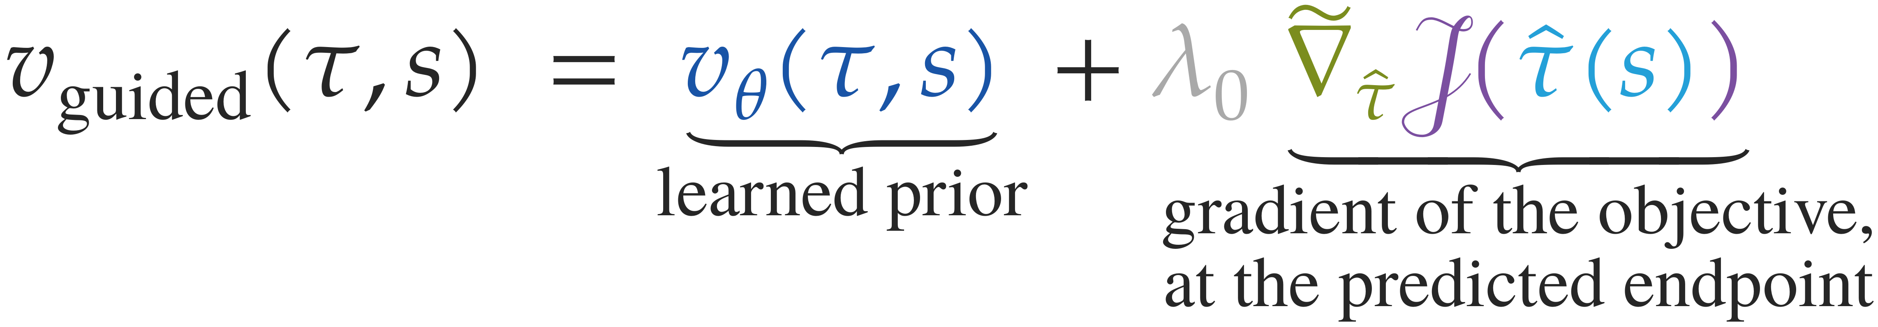
Guided velocity field
extrapolation to s = 1
τ̂, s = 1
γ Σ_{t} ‖p_{t+1} − 2p_{t} + p_{t−1}‖²
smoothness penalty
τ_{s}, s
v_{θ}(τ_{s}, s)
learned prior field
frozen during sampling
τ̂ = τ_{s} + (1 − s) v_{θ}
predicted endpoint
ρ_{φ}(τ̂)
requirement score
+
−
τ_{s}
vθ
Σ
objective 𝒥(τ̂)
λ₀ ĝ Δs
guidance term
mask and normalize
constrained coordinates to
unit direction
∇τ̂
autodiff
λ₀ ĝ Δs
vθ Δs
+
Δτ̃
re-pin
π₀(τ) = x_{start}
τ_{s+Δs}
K steps

Slide 7
Guided velocity field
extrapolation to s = 1
τ̂, s = 1
γ Σ_{t} ‖p_{t+1} − 2p_{t} + p_{t−1}‖²
smoothness penalty
τ_{s}, s
v_{θ}(τ_{s}, s)
learned prior field
frozen during sampling
τ̂ = τ_{s} + (1 − s) v_{θ}
predicted endpoint
ρ_{φ}(τ̂)
requirement score
+
−
τ_{s}
vθ
Σ
objective 𝒥(τ̂)
λ₀ ĝ Δs
guidance term
mask and normalize
constrained coordinates to
unit direction
∇τ̂
autodiff
λ₀ ĝ Δs
vθ Δs
+
Δτ̃
re-pin
π₀(τ) = x_{start}
τ_{s+Δs}
K steps

Slide 8
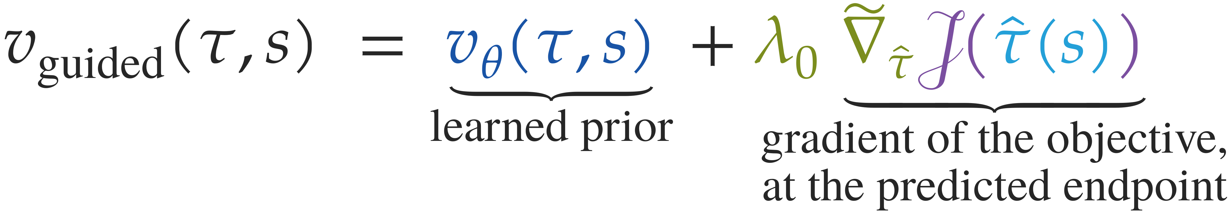
Guided velocity field
extrapolation to s = 1
τ̂, s = 1
γ Σ_{t} ‖p_{t+1} − 2p_{t} + p_{t−1}‖²
smoothness penalty
τ_{s}, s
v_{θ}(τ_{s}, s)
learned prior field
frozen during sampling
τ̂ = τ_{s} + (1 − s) v_{θ}
predicted endpoint
ρ_{φ}(τ̂)
requirement score
+
−
τ_{s}
vθ
Σ
objective 𝒥(τ̂)
λ₀ ĝ Δs
guidance term
mask and normalize
constrained coordinates to
unit direction
∇τ̂
autodiff
λ₀ ĝ Δs
vθ Δs
+
Δτ̃
re-pin
π₀(τ) = x_{start}
τ_{s+Δs}
K steps

Slide 9
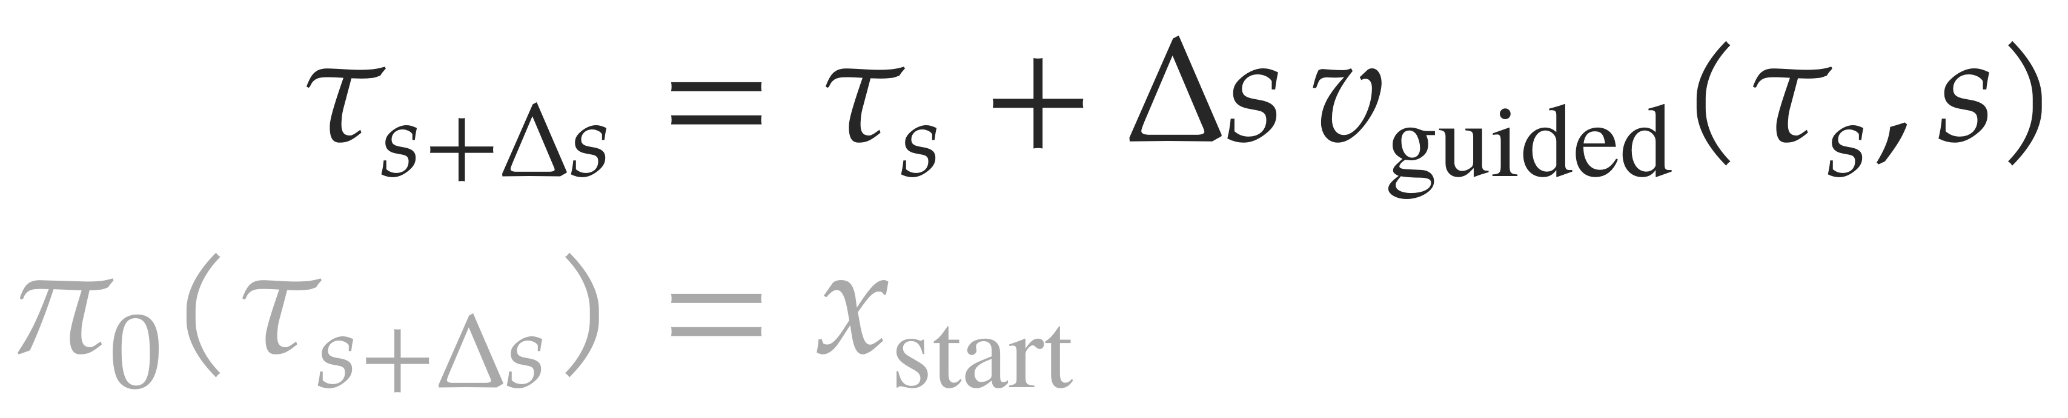
Guided velocity field
extrapolation to s = 1
τ̂, s = 1
γ Σ_{t} ‖p_{t+1} − 2p_{t} + p_{t−1}‖²
smoothness penalty
τ_{s}, s
v_{θ}(τ_{s}, s)
learned prior field
frozen during sampling
τ̂ = τ_{s} + (1 − s) v_{θ}
predicted endpoint
ρ_{φ}(τ̂)
requirement score
+
−
τ_{s}
vθ
Σ
objective 𝒥(τ̂)
λ₀ ĝ Δs
guidance term
mask and normalize
constrained coordinates to
unit direction
∇τ̂
autodiff
λ₀ ĝ Δs
vθ Δs
+
Δτ̃
re-pin
π₀(τ) = x_{start}
τ_{s+Δs}
K steps

Slide 10

Guided velocity field
extrapolation to s = 1
τ̂, s = 1
γ Σ_{t} ‖p_{t+1} − 2p_{t} + p_{t−1}‖²
smoothness penalty
τ_{s}, s
v_{θ}(τ_{s}, s)
learned prior field
frozen during sampling
τ̂ = τ_{s} + (1 − s) v_{θ}
predicted endpoint
ρ_{φ}(τ̂)
requirement score
+
−
τ_{s}
vθ
Σ
objective 𝒥(τ̂)
λ₀ ĝ Δs
guidance term
mask and normalize
constrained coordinates to
unit direction
∇τ̂
autodiff
λ₀ ĝ Δs
vθ Δs
+
Δτ̃
re-pin
π₀(τ) = x_{start}
τ_{s+Δs}
K steps

Slide 11
Guided velocity field
extrapolation to s = 1
τ̂, s = 1
γ Σ_{t} ‖p_{t+1} − 2p_{t} + p_{t−1}‖²
smoothness penalty
τ_{s}, s
v_{θ}(τ_{s}, s)
learned prior field
frozen during sampling
τ̂ = τ_{s} + (1 − s) v_{θ}
predicted endpoint
ρ_{φ}(τ̂)
requirement score
+
−
τ_{s}
vθ
Σ
objective 𝒥(τ̂)
λ₀ ĝ Δs
guidance term
mask and normalize
constrained coordinates to
unit direction
∇τ̂
autodiff
λ₀ ĝ Δs
vθ Δs
+
Δτ̃
re-pin
π₀(τ) = x_{start}
τ_{s+Δs}
K steps

